Slide 1
IMAGE CLASSIFICATION USING DEEP LEARNING (Chest Radiographs for Pneumonia)

Slide 2
Business Overview
Pneumonia is an infection that inflames the air sacs in one or both lungs.
The air sacs fill with fluid or pus and appear as ‘opacities’ on chest x-rays.
For this reason, chest x-rays are normally given to patients who present with difficulty in breathing or other signs and symptoms of pneumonia.
Interpretation of the radiographs is variable and examiner dependent.
To increase the sensitivity, specificity and turn-over time of the examination, we have used deep learning algorithm that significantly improves the detection of pneumonia in chest radiographs.

Slide 3
PROBLEM STATEMENT
Current healthcare workers’ strike has crippled operations at the radiology department in Kenyatta National Hospital due to shortage of staff.
The hospital also struggles with timely and accurate diagnosis limited by high patient volumes.

Slide 4
OBJECTIVES
01
02
03
Alleviate the strain on the hospital’s diagnostic services.
Support clinician’s decision making.
Use algorithms to classify medical images for assistance in diagnosis.

Slide 5
DATA UNDERSTANDING
The images we used were sourced from Kaggle.
3 folders: train, test and validation sets.
Images were classified as normal or having pneumonia.
The images were selected from retrospective cohorts of pediatric patients from Guangzhou.

Slide 6
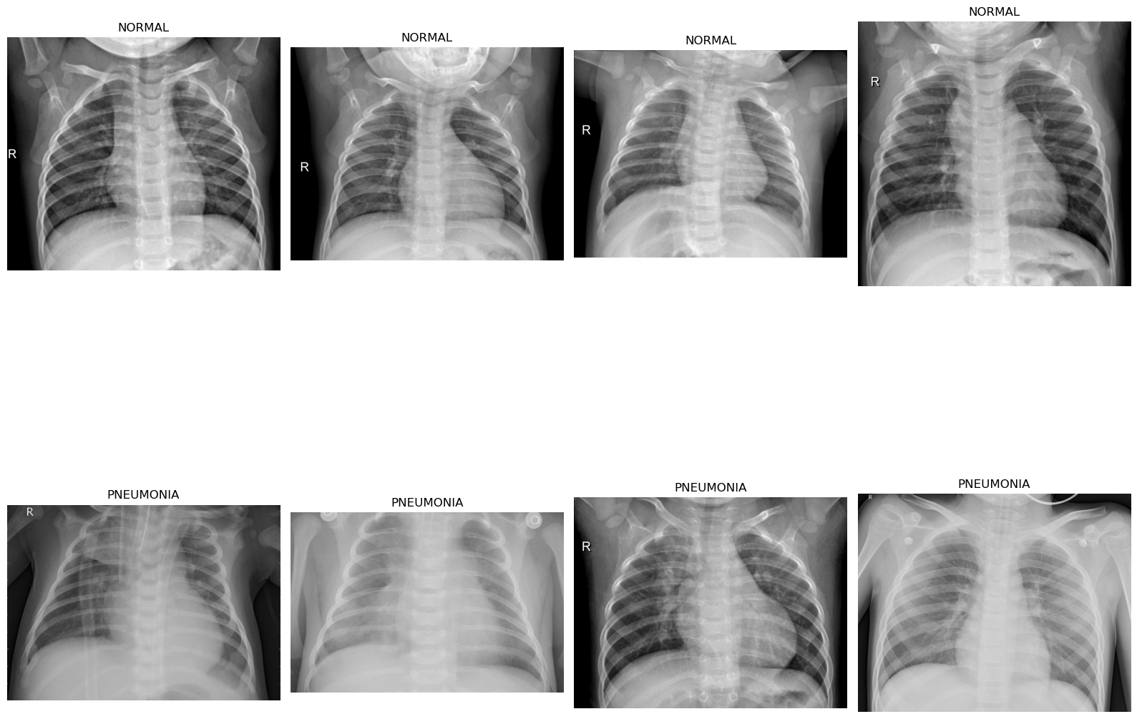
DATA UNDERSTANDING

Slide 7
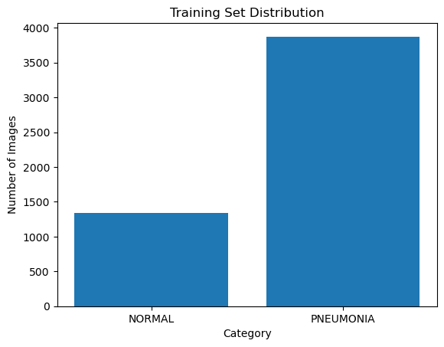
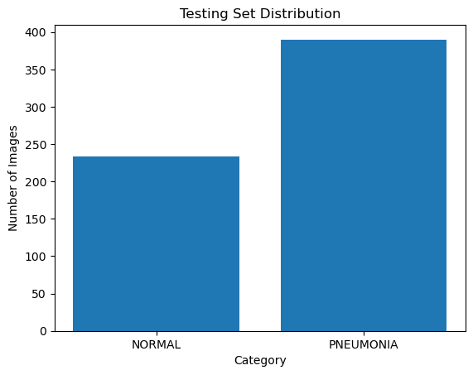
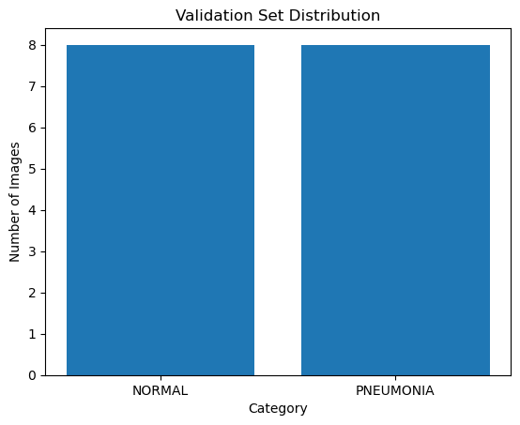
DATA UNDERSTANDING.

Slide 8
DATA PREPARATION FOR MODELLING
We used ImageDataGenerator- preparing the images in a way the computer can understand – using TensorFlow’s Keras API
We then decided on how many pictures the computer should look at each time it learns – batch number of 32.
Reshaped the images to 150pixels by 150pixels.
Create a ‘generator’ with the above instructions for each of the photos in our dataset

Slide 9
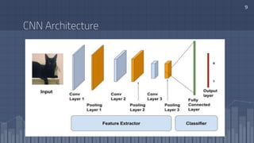
MODELLING
ResNet-50 - Transfer Learning model leveraging the ResNet50 architecture for feature extraction coupled with custom layers for the classification task
Convolutional neural network architecture.
In the Resnet-50 architecture, there are convolution layers that extract features (like opacities) from the input images, where identify block and convolution block process and transform these features. The fully connected layers are used to make the final classification.

Slide 10
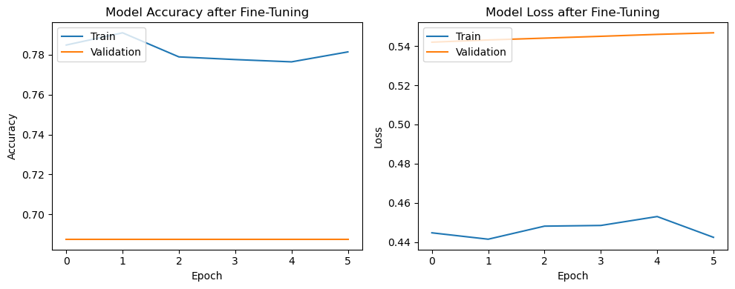
MODELLING CTD..
The model recorded an accuracy of 78.32% and a loss of 0.4388, with a summarized Training Accuracy of 78.26%.
This level of accuracy is indicative of the model’s learning capability, though lower than the accuracies observed in previous iterations, suggesting potential room for optimization.

Slide 11
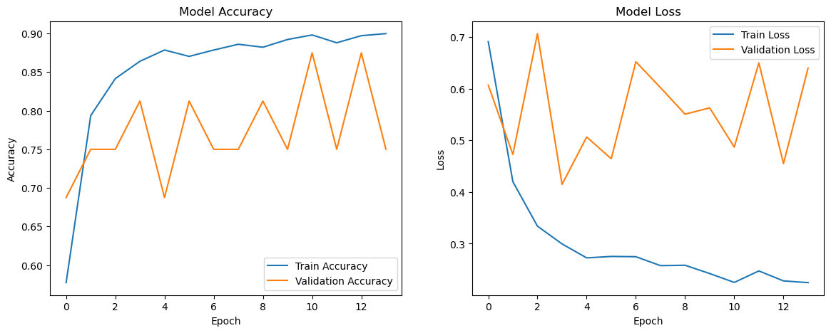
MODELLING…
We then used a Custom CNN model constructed from scratch, which incorporated a variety of data augmentation strategies- these include translation.
As seen below, the model attained an accuracy of 92.14% and a loss of 0.1883, summarized as a training accuracy of 92.16% indicative of excellent learning from the training dataset, with the model effectively minimizing error.

Slide 12
RECOMMENDATIONS.
1
2
3
Integration with portable X-ray Machines to enable healthcare providers to quickly analyze the images on site
Further hyperparameter tuning of the custom CNN model.
Evaluation of alternative architectures.
.

Slide 13
THANK YOU!

